Slide 1




OLTP vs OLAP;
Database vs Warehouse vs Lakehouse
~Md. Shabbir Hossain Bhuiyea (Rossi)
Four Types of Sentences

Slide 2

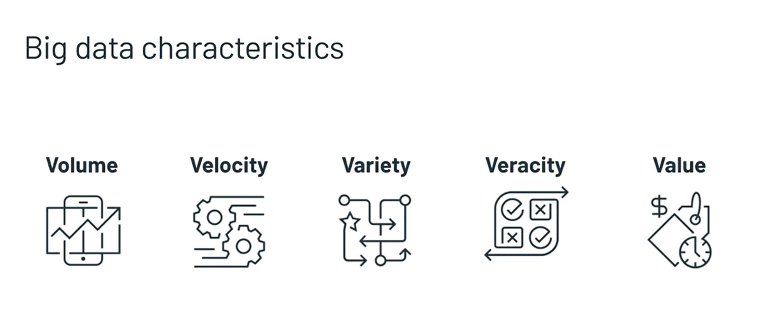
What is BIG DATA?

Slide 3

OLTP
OLAP
Online Transaction Process
Online Analytical Process
Applied on Data Warehouses
Transactional Database Architecture
Banking, Ecommerce Transaction
For BI, Reporting

Slide 4
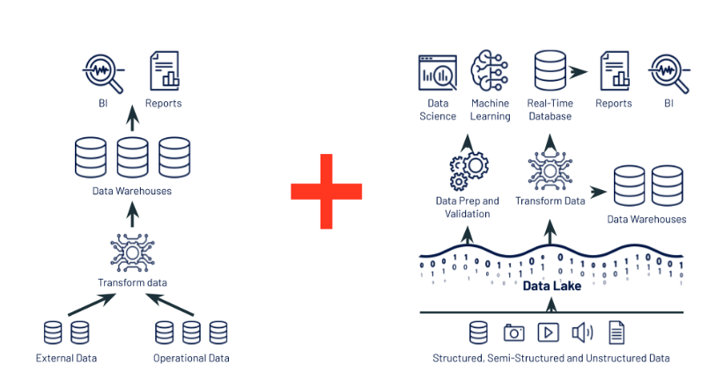
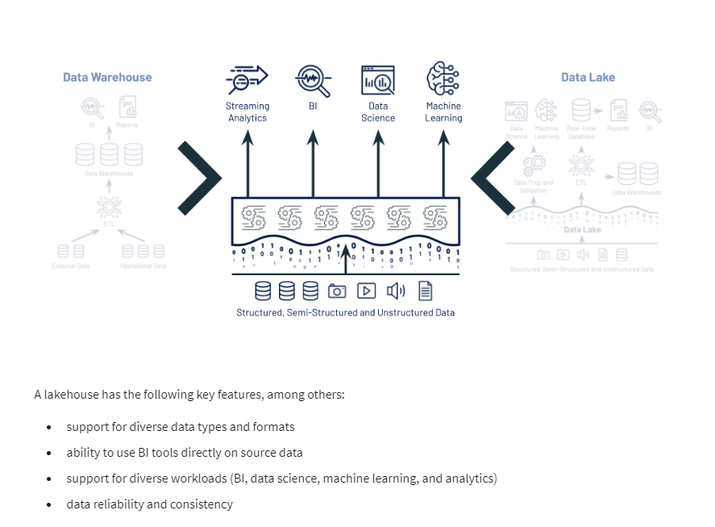
Data Warehouse, Data Lake, Lake House

Slide 5
